Slide 1
How to Get Kids to Read? REALLY READ!
Sue Kaiser, Ed.D.

Slide 2
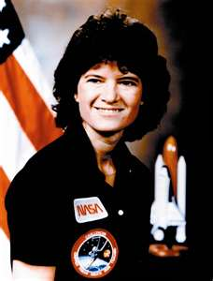
Sally Ride
Notes:
Sue

Slide 3
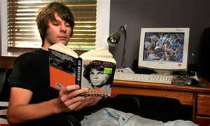
Improving Adolescent Literacy
Notes:
Startling facts – interactive activity
Identify problem

Slide 4
Lexile Levels of Books 2011
Notes:
Marilyn adams Sue

Slide 5
Lexile of the Spoken Word
Notes:
What reading does for the mind Sue

Slide 6
Common Core State Standards 2014?
Notes:
With the common core coming, students will be tested on their ability to read and comprehend in the core content areas. Teaching reading comprehension becomes every teachers issue, not just the reading teacher. Greg

Slide 7
How To Teach: Text Structure
Notes:
Greg

Slide 8
FOCUS
Notes:
Sue

Slide 9
Reading Campaign
The Missing Piece
Reading Logs – parent signature
Accelerated Reader

Slide 10
The missing piece
15 minutes each day (aim for 30), commit to have sustained reading in your classroom
During this time, actively walk around asking your students questions about the structure of their text:
“what is your main character doing right now, what problem are they having?”,
“where does your story take place?”
“What is it that your author is trying to teach you?”
This activity tells your students that independent reading is important and helps them to apply the skills and strategies learned during your direct teaching.

Slide 11
Missing piece #1
What does this walk about do?????
You will notice what level your students are reading – are they at the appropriate level for their reading skill and you will be able to make some readjustments.

Slide 12
Missing piece #2
2. You will notice what genre your students are interested in and you can steer them toward books that you might know about that they have not discovered.

Slide 13
Missing piece #3
3. You will be able to see if your marginal readers are always on chapter 1 – trading their book in for a new one before they even get to the interesting part. Once you find these students, you can have a coaching session with them where you explain the structure of the story and how the first, second and sometimes third chapters in books are boring because the author is doing their job of setting up the story: the setting, characters and time zone. Once the author does this, then they will put some action that causes surprise and wonder and this is when the book becomes interesting.

Slide 14
Missing Piece #4
4. You model for the students the importance of recreational reading. You will have the opportunity to teach students how to read recreationally. If we truly believe that this is an important part of our program, it must be taught with the human connection and not just assigned and monitored.

Slide 15
Conclusion
So What Next?

Slide 16
One Ride!

