Slide 1
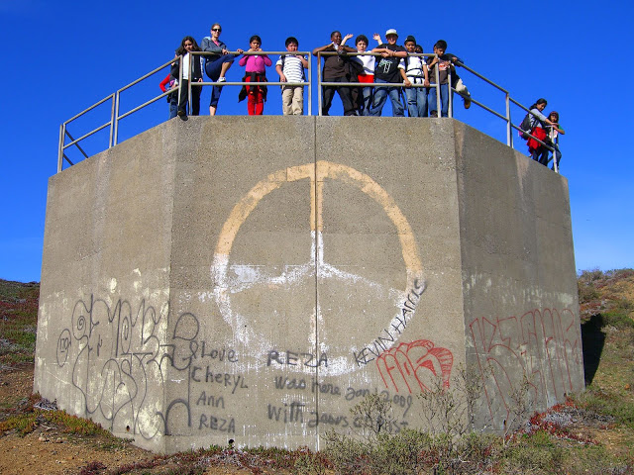
Alumni Night 2015
Think College Now

Slide 2
31:39
1
7
22
6
Notes:
Key numbers—2014 1st class of TCN students finished HS & went to college
31:39 finished high school and attending college
-6 UC
-7 CSU
-1 Private
22 community college

Slide 3



















Slide 4






Notes:
Meritt College
UCLA

Slide 5


Slide 6
